Slide 1
Introduction to Docker

Slide 2
What is Docker?
Docker is an open-source platform used to develop, package, distribute, and run applications inside containers.
A Docker container contains:
Application source code
Runtime environment
Required libraries
Dependencies
Configuration files
System tools

Slide 3
Containers are lightweight because they share the host operating system kernel. Containers are portable, allowing applications to run consistently across different environments.
Containers provide process and filesystem isolation, helping applications run independently. Docker helps developers avoid the common problem:
"It works on my machine, but not on another machine."
Docker is widely used in DevOps, CI/CD, cloud computing, microservices, and application deployment.

Slide 4
Docker enables you to separate your applications from your infrastructure so you can deliver software quickly.
With Docker, you can manage your infrastructure in the same ways you manage your applications.
It is a containerization platform that allows developers to package programs into containers.
It was written in the Go language developed by Google.
In simpler words, Docker lets you run your operating system as a container.

Slide 5
Essential Elements of Docker
Among the essential elements of Docker are the following:
Docker Engine: This essential component of Docker manages container formation and administration.
Docker Image: The application code and dependencies are contained in the Docker Image, a read-only template used to create containers.
Docker Hub: A cloud-based repository called Docker Hub is used to locate and distribute container images.
Dockerfile: A script that includes instructions for creating a Docker image is called a Dockerfile.
Docker Registry: A storage distribution method for Docker images, the Docker Registry allows you to store the images in both private and public modes.

Slide 6
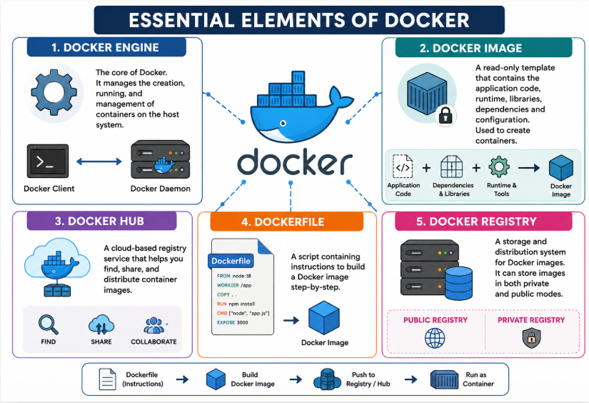

Slide 7
What are Containers?
A container is a unit that packages up the code, process, networking, OS, and all of its attributes, dependencies, and configuration.
One can create files and save them in a container.
It is a place where the live application runs.
It is portable; now we can send this container to any system in which the docker is installed.
It can be run, started, stopped, and deleted.
The container will work the same as it was working before shifting from one system to another.
Once a container is destroyed the data will be lost.

Slide 8
Docker Engine
Docker Engine is the layer on which Docker runs.
It is installed on the host machine.
It’s a lightweight runtime and tooling that manages containers, images, builds, and more.
Docker Engine acts as a client-server application with:
A server with a long-running daemon process dockerd.
Rest APIs which specify interfaces that programs can use to talk to and instruct the Docker daemon.
A command line interface (CLI) client docker.

Slide 9
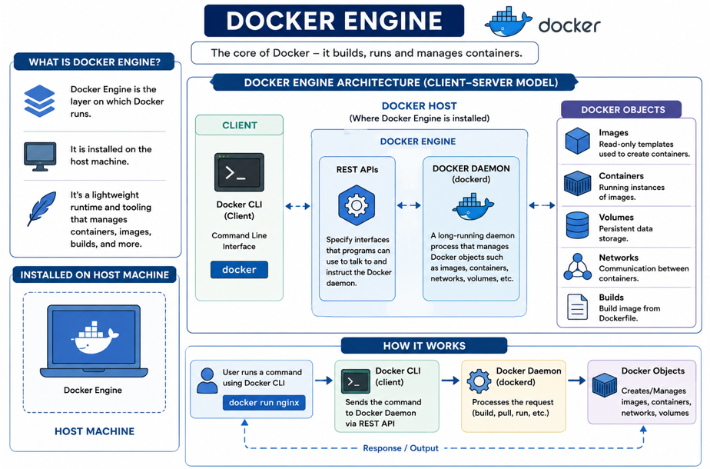
Docker Engine

Slide 10
Docker Architecture
Docker follows a Client–Server architecture.
It has different components that work together to run applications in containers.
The Docker Client is where the user gives commands.
The Docker Daemon receives and executes these commands.
The Docker Host is the machine where Docker runs.
Docker Images are templates used to create containers.
Containers are running instances of Docker images.
Docker Registry stores and distributes Docker images.

Slide 11
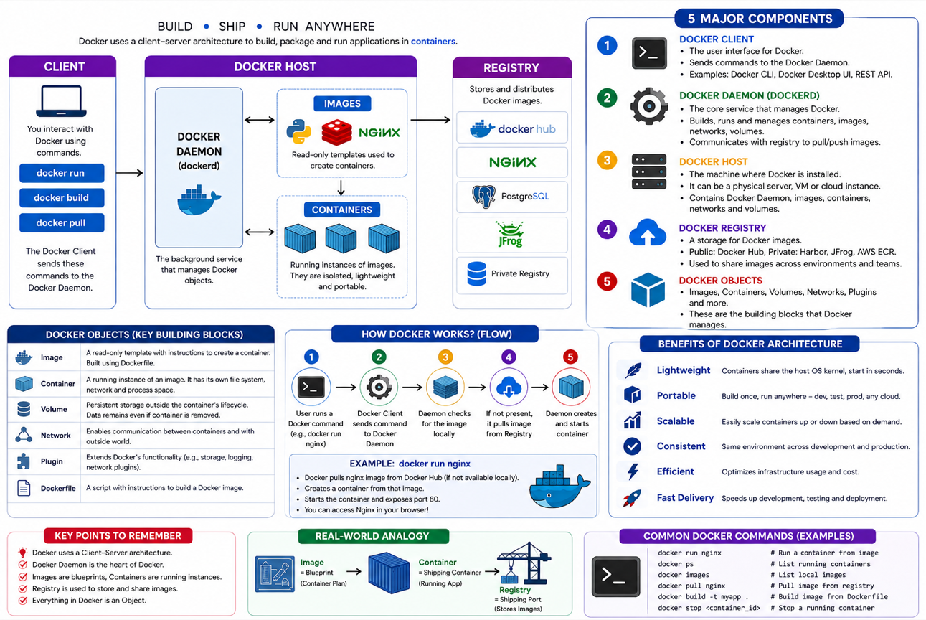
Docker Architecture

Slide 12
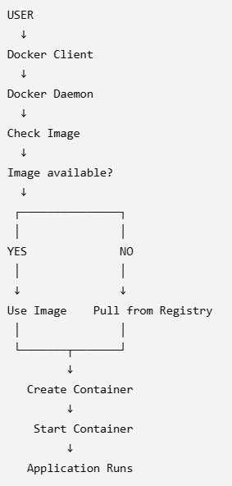

Slide 13
Docker Architecture
Docker Client
Helps users to interact with Docker.
It communicates with the Docker Daemon using the commands and rest APIs.
Docker client provides a command-line interface (CLI) that allows users to run, and stop application commands to a Docker daemon.
Docker Daemon
It runs on the operating system of the host.
It handles Docker objects e.g images, containes, network and volumes by listening for Docker API requests.
It is used to run containers and also manage services of the Docker.
A Daemon can communicate with other Daemons to manage services.
Itis responsible for handling the construction, execution and distribution of Docker containers.

Slide 14
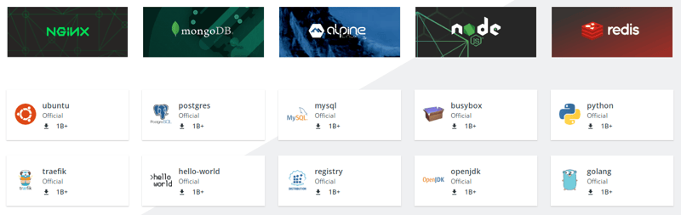
Docker Architecture
Docker Host
It is very important because without it, users cannot make use of Docker.
It is an environment in which applications can be executed and run.
Commands issued by the client are sent over to the docker host which is received by the Docker daemon.
Docker Registry
Docker Registry also known as Docker Hub is a repository of Docker images for almost all technology stack where you can install or pull images.

Slide 15
Docker Objects
These are what we interact with while using Docker, for example you use images, containers, volumes, networks or plug-ins

Slide 16
Docker Image vs Docker Container
Docker Image | Docker Container
Blueprint/template | Running instance
Usually read-only | Has writable layer
Used to create containers | Created from an image
Can create many containers | Represents one running instance
Stored locally/registry | Runs on Docker Host
Simple Example
Image = Class definition
Container = Object created from the class

Slide 17
Important Docker Commands
Command | Purpose
docker --version | Check Docker version
docker pull nginx | Download image
docker images | List images
docker run nginx | Create and start container
docker ps | List running containers
docker ps -a | List all containers
docker stop ID | Stop container
docker start ID | Start container
docker rm ID | Remove container
docker rmi nginx | Remove image

Slide 18
Who actually creates the container—the Client or Daemon?
What is the difference between an Image and Container?
Where are Docker images stored?
What happens if the required image is not available locally?
Can one image create multiple containers?
Which component communicates with the Registry?
What command downloads an image?
What command creates and starts a container?
What does docker ps show?
What is the role of a Dockerfile?

Slide 19
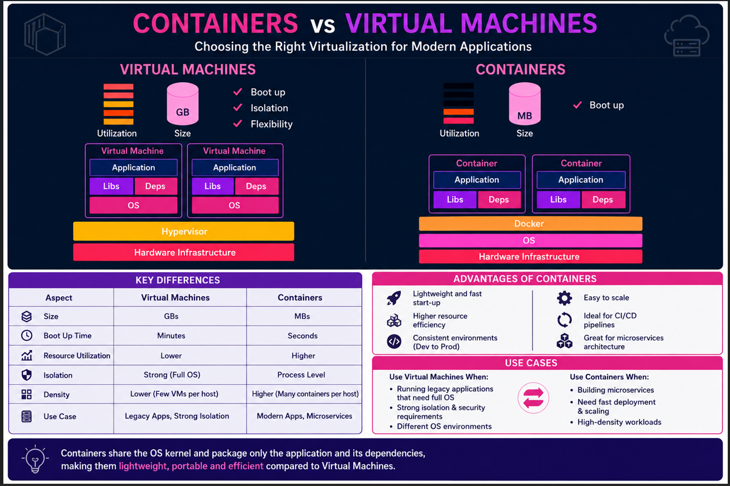
Notes:
Virtual Machine: Virtualizes the entire computer system, including a complete operating system. Container: Virtualizes the application environment, while sharing the host operating system's kernel.
Containers vs. Virtual Machines — Detailed Explanation
The infographic compares Virtual Machines (VMs) and Containers, focusing on how they use hardware, operating systems, resources, and how applications are deployed.
1. Basic Concept
Both VMs and containers solve a similar problem:
How can we run multiple applications or workloads on the same physical machine while keeping them isolated?
The major difference is what gets virtualized.
Virtual Machine: Virtualizes the entire computer system, including a complete operating system.
Container: Virtualizes the application environment, while sharing the host operating system's kernel.

Slide 20
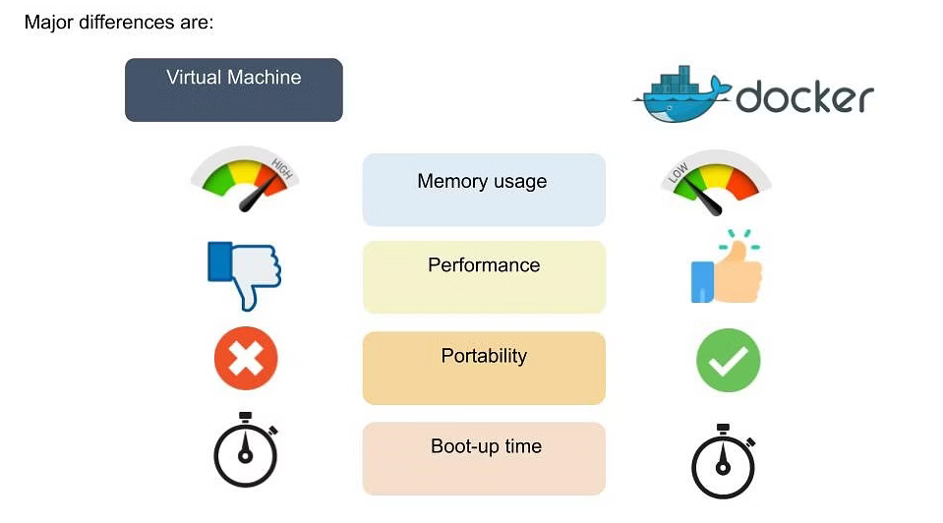
Docker vs Virtual Machines

Slide 21
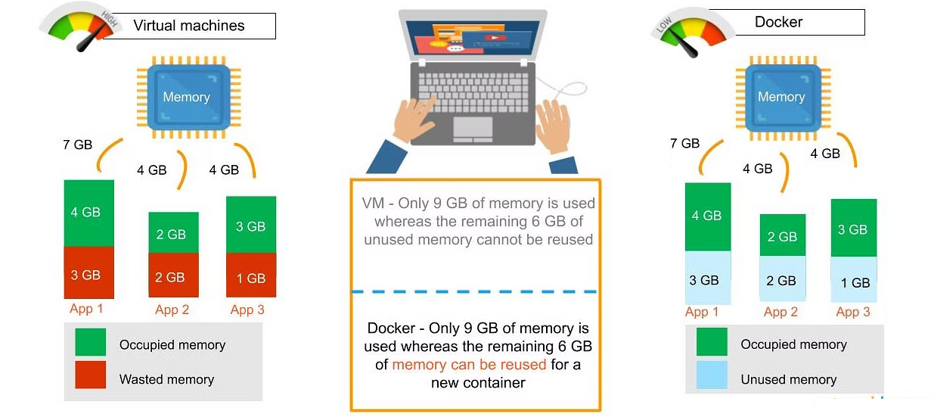

Slide 22
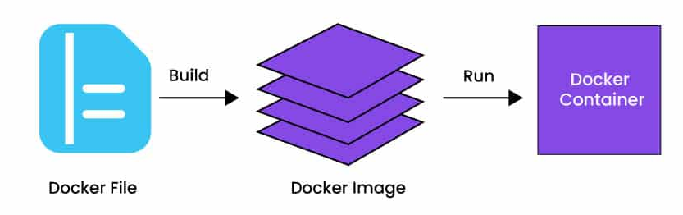
What is Dockerfile:
A Dockerfile is a text file used to define the configuration of a Docker container.
It contains a set of instructions that Docker uses to automatically create a container image.
These instructions specify the base image, set up dependencies, copy files, configure environment variables, and define how the container should run.
Dockerfiles simplifies the creation and replication of consistent container environments, enabling
easy sharing and deployment of applications across different system.
Notes:
Dockerfile → Recipe Docker Image → Prepared food/package Container → Running food service

Slide 23
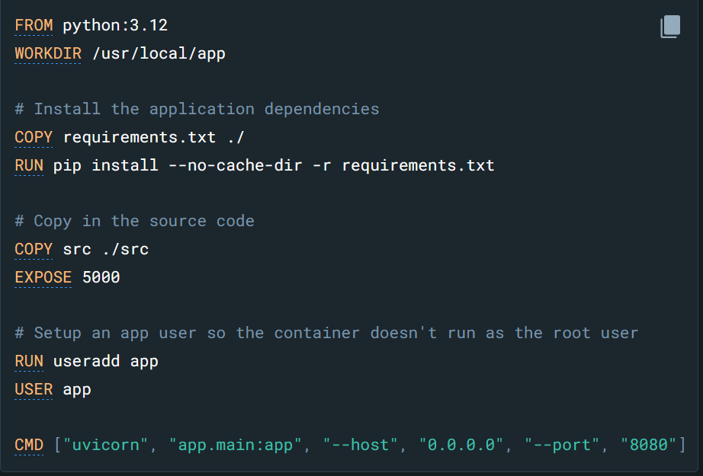
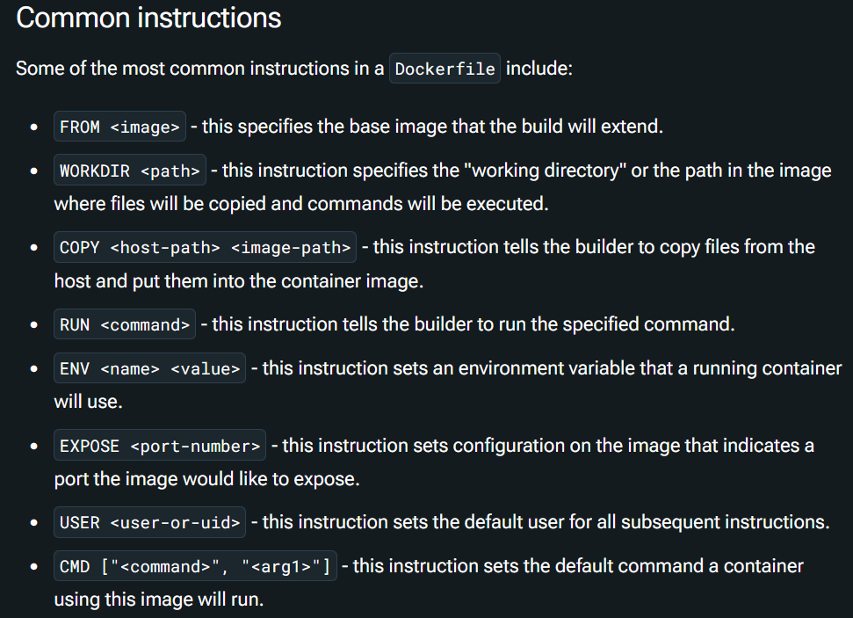

Slide 24
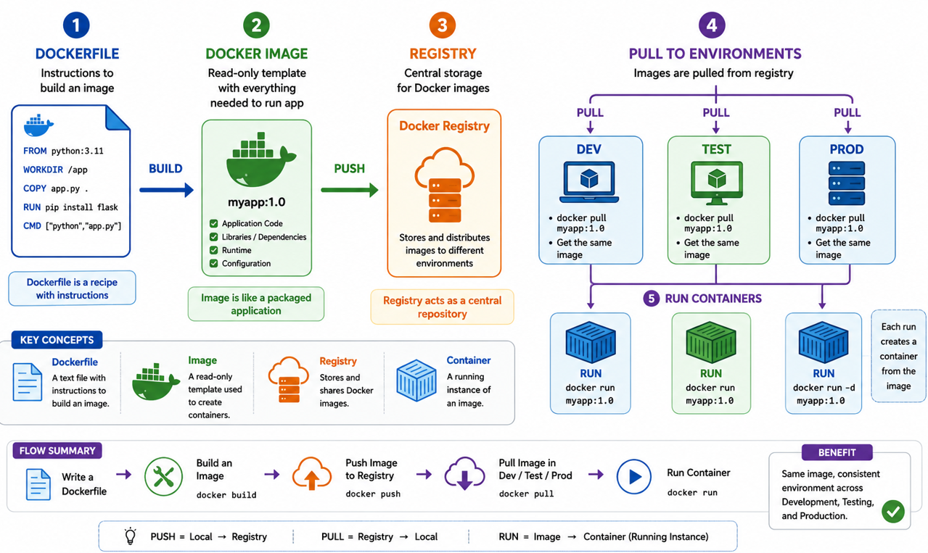
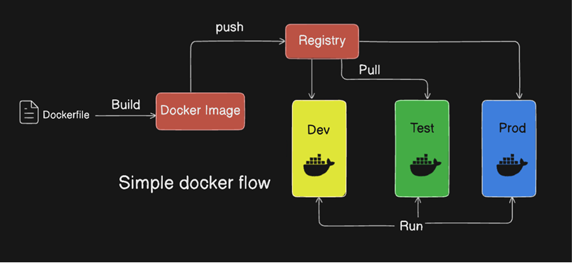
A Simple Docker WorkFlow

Slide 25
Build: Create a Docker image from a Dockerfile.
Push: Upload the image to an intermediate registry or Docker Hub.
Pull: Download the image from the registry.
Run: Deploy the container from the image.
Share (Optional): You can push your image to a registry (like Docker Hub) to share it with others.

Slide 26
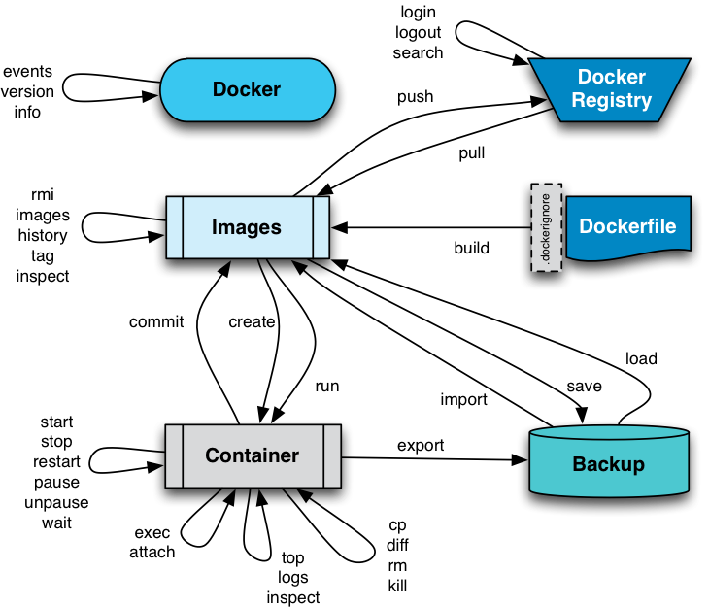
Docker Commands:
https://ibrahims.medium.com/docker-full-commands-cbabb0036548

Slide 27
What is an image?
There are two important principles of images:
Images are immutable. Once an image is created, it can't be modified. You can only make a new image or add changes on top of it.
Container images are composed of layers. Each layer represents a set of file system changes that add, remove, or modify files.

Slide 28
Deploying Jenkins on Docker
Step 1: Install Docker
Step 2: Pull the Jenkins Docker Image
  docker pull jenkins/Jenkins
Step 3: Create a Docker Volume (Optional)
  docker volume create jenkins_volume
Step 4: Run the Jenkins Docker Container
  docker run -d -p 8080:8080 -p 50000:50000 --name jenkins –mount source=jenkins_volume,target=/var/jenkins_home jenkins/Jenkins
Step 5: Access the Jenkins Web Interface
Step 6: Retrieve the Initial Admin Password
  docker exec jenkins cat /var/jenkins_home/secrets/initialAdminPassword

Slide 29
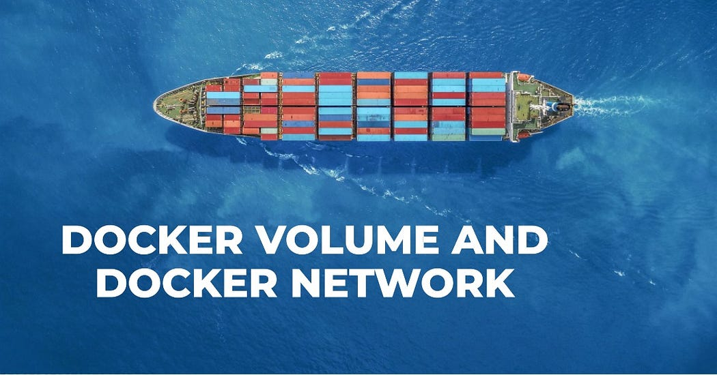

Slide 30
Docker Volume
Docker Volume is a storage mechanism that is used for persisting data generated by and used by Docker containers.
Docker Volumes are managed by Docker itself and are independent of the container lifecycle.
This means that the data in a volume is not lost when a container is stopped or deleted, and can be easily backed up or migrated.

Slide 31
Docker Volumes have several advantages over other methods of storing data in containers, such as:
Volumes are easier to use and more flexible than bind mounts, which depend on the directory structure and OS of the host machine.
Volumes can be shared and reused among multiple containers, even across different hosts.
Volumes can use different drivers to store data on remote hosts, and cloud providers, or to encrypt or compress the data.
Volumes can be created with default content from an existing container or image.

Slide 32
Docker Network
Docker Network is a virtual network created by Docker to enable communication between Docker containers.
Docker Network allows containers to connect to each other and to non-Docker workloads, such as external services or databases.
Docker Network also provides network isolation and security for containers.

Slide 33
Docker Network supports different types of networks
Bridge: The default network type that connects containers to a private network on the host machine.
Containers on the same bridge network can communicate with each other by name or alias, while containers on different bridge networks need to use port mapping or links to communicate.
Host: A network type that connects containers directly to the host’s network stack, without any isolation.
Containers on the host network can communicate with each other and with any other process on the host, but they cannot use port mapping or links.

Slide 34
Docker Network supports different types of networks
Overlay: A network type that connects containers across multiple hosts or clusters, using a distributed key-value store such as Consul or etcd.
Containers on the same overlay network can communicate with each other by name or alias, regardless of their physical location.
Macvlan: A network type that assigns a MAC address to each container and connects them to the host’s physical network interface, without any isolation.
Containers on the same macvlan network can communicate with each other and with any other device on the same subnet, but they cannot communicate with the host machine.
None: A network type that disables networking for a container, providing only a loopback interface.
Containers on the none network cannot communicate with any other container or process.

Slide 35
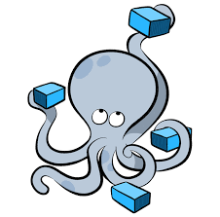
Docker Compose
What and why Docker Compose
Install Docker Compose
How To create Docker Compose file
How to use Docker compose file to create services

Slide 36
What is Docker Compose?
docker-compose -v
Docker Compose is a tool that makes it easier to create and run multi-container applications.
It automates the process of managing several Docker containers simultaneously, such as a website frontend, API, and database service.
Docker Compose allows you to define your application’s containers as code inside a YAML file you can commit to your source repository.
Once you’ve created your file (normally named docker-compose.yml), you can start all your containers (called “services”) with a single Compose command.
Compose automatically creates a Docker network for your project, ensuring your containers can communicate with each other.
It also manages your Docker storage volumes, automatically reattaching them after a service is restarted or replaced

Slide 37
Why use Docker Compose?
Most real-world applications have several services with dependency relationships
for example, your app may run in one container, but depend on a database server that’s deployed adjacently in another container.
Moreover, services usually need to be configured with storage volumes, environment variables, port bindings, and other settings before they can be deployed.
Compose lets you encapsulate these requirements as a “stack” of containers that’s specific to your app.
Using Compose to bring up the stack starts every container using the config values you’ve set in your file.
This improves developer ergonomics, supports reuse of the stack in multiple environments, and helps prevent accidental misconfiguration.

Slide 38
What is the difference between Docker and Docker Compose?
Docker is a containerization engine that provides a CLI for building, running, and managing individual containers on your host.
Compose is a tool that expands Docker with support for multi-container management.
It supports “stacks” of containers that are declaratively defined in project-level config files.

Slide 39
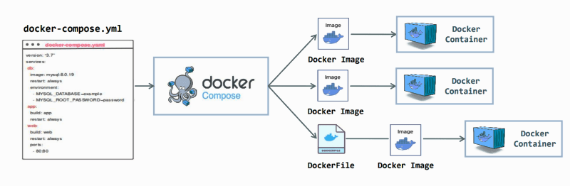
Docker Compose benefits
Below are some of the benefits of using Docker Compose:
Fast and easy configuration with YAML scripts
Single host deployment
Increased productivity
Security with isolated containers

Slide 40
Docker Compose Demo
Using Docker Compose
1. Check if Docker Compose is installed
  docker compose version
2. Create Your Application
  Create app.js file
  Create dockerfile
3. Create a Docker Compose file
  Container 1 – The Node.js server app you’ve created.
  Container 2 – A Redis instance for your Node.js app to connect to.
4. Bring Up Your Containers

Slide 41
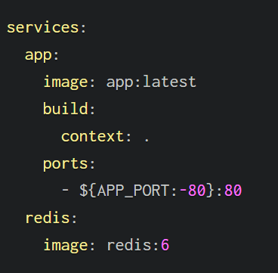
The top-level services field is where you define the containers that your app requires.
Two services are specified for this app: app (your Node.js application) and redis (your Redis server).
Each service has an image field that defines the Docker image the container will run.
In the case of the app service, it’s the custom app:latest image. As this may not exist yet, the build field is set to tell Compose it can build the image using the working directory (.) as the build context.
The redis service is simpler, as it only needs to reference the official Redis image on Docker Hub.
The app service has a ports field that declares the port bindings to apply to the container, similarly to the -p flag of docker run.
An interpolated variable is used; this means that the port number given by your APP_PORT environment variable will be supplied when it’s set, with a fallback to the default port 80.

Slide 42
What is YAML?
YAML stands for Yet Another Markup Language or YAML Ain’t Markup Language (a recursive acronym), depending on whom you ask.
YAML is a data serialization language that is designed to be easy to read and write by humans.
YAML is commonly used for writing configuration files and in applications where data is being stored or transmitted.
YAML has a simple syntax that uses indentation, colons, dashes, and brackets to represent the structure and values of data.
YAML supports scalars (such as strings, numbers, and booleans), lists (or sequences), and maps (or dictionaries).
YAML also allows you to define custom data types and aliases for reusing data

Slide 43
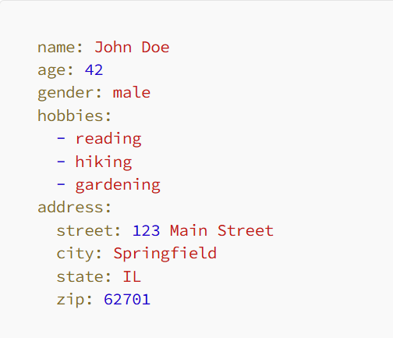
YAML

Slide 44
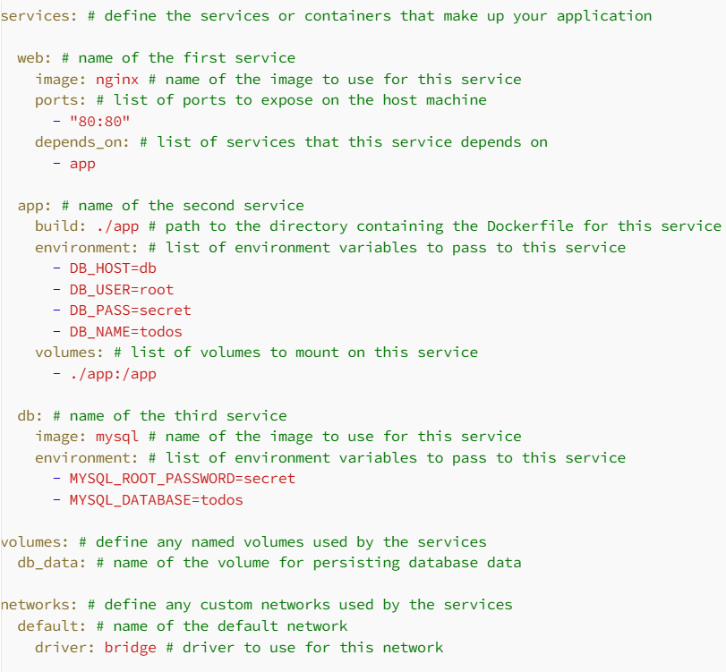
docker-compose.yml file

Slide 45
YAML
This file defines an application that consists of three services:
web: A web server that uses the nginx image and exposes port 80 on the host machine.
It depends on the app service.
app: A web application that uses a custom image built from the Dockerfile in the ./app directory.
It passes some environment variables related to the database connection and mounts the ./app directory as a volume on the container.
db: A database server that uses the mysql image and passes some environment variables related to the database creation and password.
It uses a named volume called db_data to persist its data.

Slide 46
Commands
To run this application using Docker Compose
  docker compose up / docker compose up -d
  -d which means they run in the background.
To stop and remove the services
  docker compose down
  This will stop and remove the containers, networks, volumes, and images created

Slide 47
Docker Container Lifecycle Management
The Docker Container Lifecycle describes the various stages that occur when we create a Docker container. Among the states are:
Created: A container that has been created but not started
Running: A container running with all its processes
Paused: A container whose processes have been paused
Stopped: A container whose processes have been stopped
Deleted: A container in a dead state

Slide 48
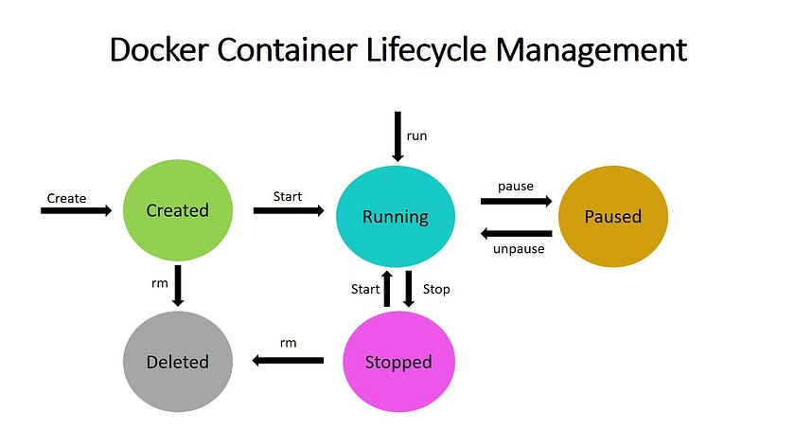

Slide 49
Created state
In the created state, a docker container is created from a docker image.
  docker create --name <name-of-container> <docker-image-name>
Running state
When the docker container is running, it begins executing the commands shown in the image.
The docker run command is used to start a docker container.
  docker run <container-id>
  or
  docker run <container-name>
If no container is present, the docker run command creates one. In this case, the container creation can be skipped.

Slide 50
Paused state
  The current command in the docker container is paused when it is in the paused state. To pause a running container, use the docker pause command.
  docker pause container <container-id or container-name>
Note: docker pause pauses all the processes in the container. It sends the SIGSTOP signal to pause the processes in the container.
Unpaused state
  When the container is unpaused, it resumes executing the commands that were paused. Then, Docker sends the SIGCONT signal to resume the process.
  docker unpause <container-id or container-name>

Slide 51
Stopped state
  The container’s main process is gracefully shutdown in the stopped state.
  Docker sends SIGTERM for graceful shutdown and SIGKILL to kill the container’s main process if necessary.
  To stop a container, use the docker stop command.
docker stop <container-id or container-name>
Restarting a docker container would result in a docker stop followed by a docker run, i.e., stop and run phases.
Killed/Deleted state
The container’s main processes are terminated abruptly in the killed state.
Docker sends a SIGKILL signal to the container’s main process to terminate it.
docker kill <container-id or container-name>

Slide 52
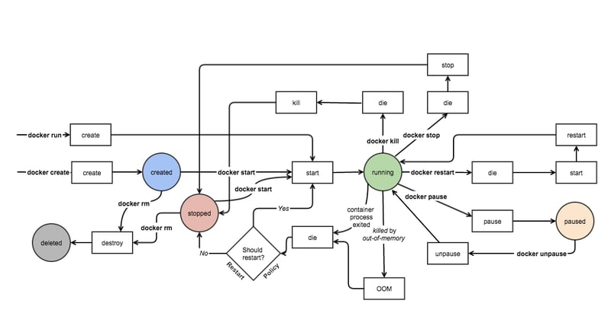
Complete lifecycle of a Docker container

Slide 53
Port Mapping in Docker
In Docker, a container is an isolated environment that runs applications and services, similar to a physical or virtual machine.
Just like these machines, containers have their own set of ports.
However, by default, these ports are not directly accessible from outside the container.
This is where port mapping, also known as port forwarding, comes into play.
Port mapping allows you to expose the ports within a Docker container, making the services running inside the container accessible to the host system or to other containers within the Docker environment.

Slide 54
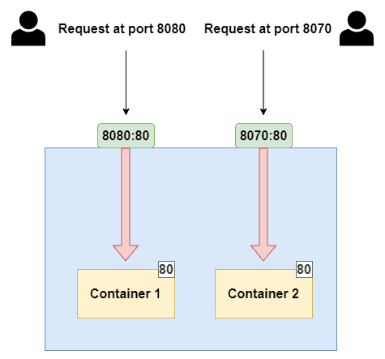
Port Mapping in Docker
Port: Ports are numeric identifiers used to differentiate between different network services running on the same host.
Ports are categorized into two groups: well-known ports (ranging from 0 to 1023) and dynamic or private ports (ranging from 1024 to 49151).
Well-known ports are reserved for commonly used services like HTTP (port 80) and HTTPS (port 443).

Slide 55
Host Port vs. Container Port:
Host Port: This is a port on the host system, which is the machine where Docker is running.
The host port is used to access the service or application running inside the Docker container from the host machine or from external systems.
Container Port: This is the port on which the service or application inside the Docker container is listening.
It may be a specific port required by the application, for example, a web server listening on port 80.

Slide 56
Difference between the -p and -P options in Docker:
-p (or –publish):
The -p (or –publish) option is used to explicitly specify port mappings when running a Docker container.
It allows you to map a specific port on the host system to a specific port inside the container. The syntax for using -p is -p <host_port>:<container_port>.
For Example:
1. Deploy an nginx container by exposing its port to 8080.
docker run --name web1 -dit -p 8080:80 nginx
docker ps # list containers

Slide 57
-P (or –publish-all):
The -P (or –publish-all) option is used to automatically publish all exposed ports defined in the Docker image to random ports on the host system.
When you use -P, Docker assigns random available ports on the host for each exposed port in the container.
For example:
1. Deploy an nginx container by exposing its port to any random port using ‘-P’
  $ docker run --name web2 -dit -P nginx
  $ docker ps

Slide 58
Common Use Cases for Port Mapping:
Exposing Web Services:
  Port mapping is frequently employed to expose web services running inside containers.
  This includes web servers like Nginx or Apache, or web applications. Port mapping allows users to access these services via a web browser.
Database Access:
  Port mapping can be used to connect containers to database servers.
  This enables applications running in containers to interact with database services running outside of the containers.
Load Balancing:
  Port mapping plays a role in load balancing strategies, where multiple containers providing the same service are mapped to the same host port.
  This ensures even distribution of incoming requests.

Slide 59
Exploring Docker Running Modes: Foreground vs. Detached
Docker offers two primary running modes: Foreground Mode and Detached Mode, each serving different use cases.
Let's break down these modes and explore when and why to use them.

Slide 60
Foreground Mode (Interactive Mode)
To run a container in the foreground, simply use the docker run command without any additional flags:
In Foreground Mode, the Docker container runs attached to your terminal, allowing you to interact with the container in real-time.
This is particularly useful for debugging, testing, or running commands interactively within the container.
How to Run in Foreground Mode:
To run a container in the foreground, simply use the docker run command without any additional flags.
docker run <image-name>
This command runs the container in your terminal, displaying all logs and output from the container. The moment you exit or stop the terminal, the container stops as well.

Slide 61
When to Use Foreground Mode:
Debugging and Testing: Foreground mode is perfect for troubleshooting.
You can monitor what's happening inside the container, interact with it, and stop it easily when you're done.
Short-Lived Tasks: For tasks that complete quickly, such as running scripts or building software, foreground mode lets you monitor the process directly.

Slide 62
Detached Mode
In Detached Mode, the container runs in the background, freeing up your terminal for other tasks.
This mode is ideal for long-running applications or services that need to run continuously without tying up your terminal.

Slide 63
How to Run in Detached Mode:
To run a container in detached mode, use the -d flag:
docker run -d <image-name>
Once the container starts, it runs in the background, and Docker returns the container ID.
You can then manage the container using other Docker commands.

Slide 64
When to Use Detached Mode:
Background Services: If you're running a web server, database, or any long-running application, detached mode ensures the container runs independently of your terminal session.
Multiple Containers: Detached mode is useful when managing multiple containers at once, allowing you to start and run various services without cluttering your terminal.

Slide 65
Switching Between Modes
While these modes may seem like separate options, Docker allows you to switch between them using the docker attach and docker exec commands.
docker attach: You can attach to a running container in detached mode to view the logs or interact with it as if it were running in foreground mode.
docker attach <container-id>
docker exec: This command lets you run additional commands inside a running container without stopping it.
For instance, you can start a shell session in a detached container for troubleshooting.
docker exec -it <container-id> /bin/bash

